Slide 1
CSE 460: VLSI Design
Lecture 9: Finite State Machines (part 2)

Slide 2
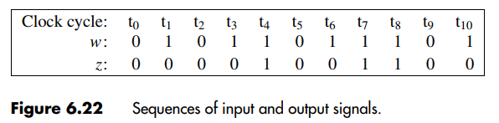
Example 2: A Simple Input Pattern (‘11’ Overlapping Sequence) Detection Circuit (Mealy Type)
Steps->
State diagram
State table
State assigned table
K-map
Circuit

Slide 3
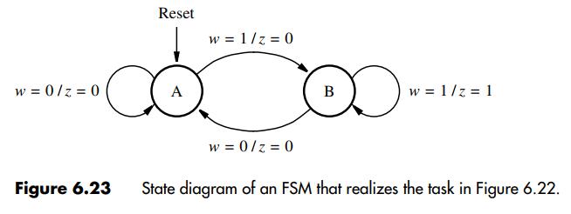
Example 2: A Simple Input Pattern (‘11’ Overlapping Sequence) Detection Circuit (Mealy Type)
Steps->
State diagram
State table
State assigned table
K-map
Circuit

Slide 4
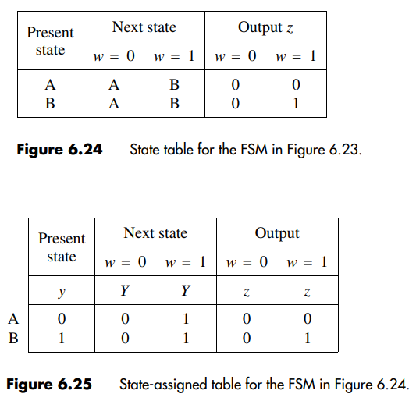
Example 2: A Simple Input Pattern (‘11’ Overlapping Sequence) Detection Circuit (Mealy Type)
Steps->
State diagram
State table
State assigned table
K-map
Circuit
Note that,
Y = f(w,y)
z = f(w,y)

Slide 5
Example 2: A Simple Input Pattern (‘11’ Overlapping Sequence) Detection Circuit (Mealy Type)
Steps->
State diagram
State table
State assigned table
K-map (Y and z)
Circuit
Y =>
w
y
0
1
0
0 | 1
0 | 1
Y = w
1
z =>
w
y
0
1
Note that,
Y = f(w,y)
z = f(w,y)
0
0 | 0
0 | 1
z = wy
1

Slide 6
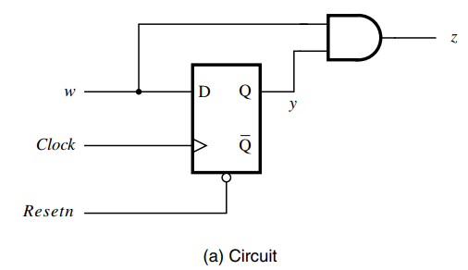
Example 2: A Simple Input Pattern (‘11’ Overlapping Sequence) Detection Circuit (Mealy Type)
Steps->
State diagram
State table
State assigned table
K-map
Circuit

Slide 7
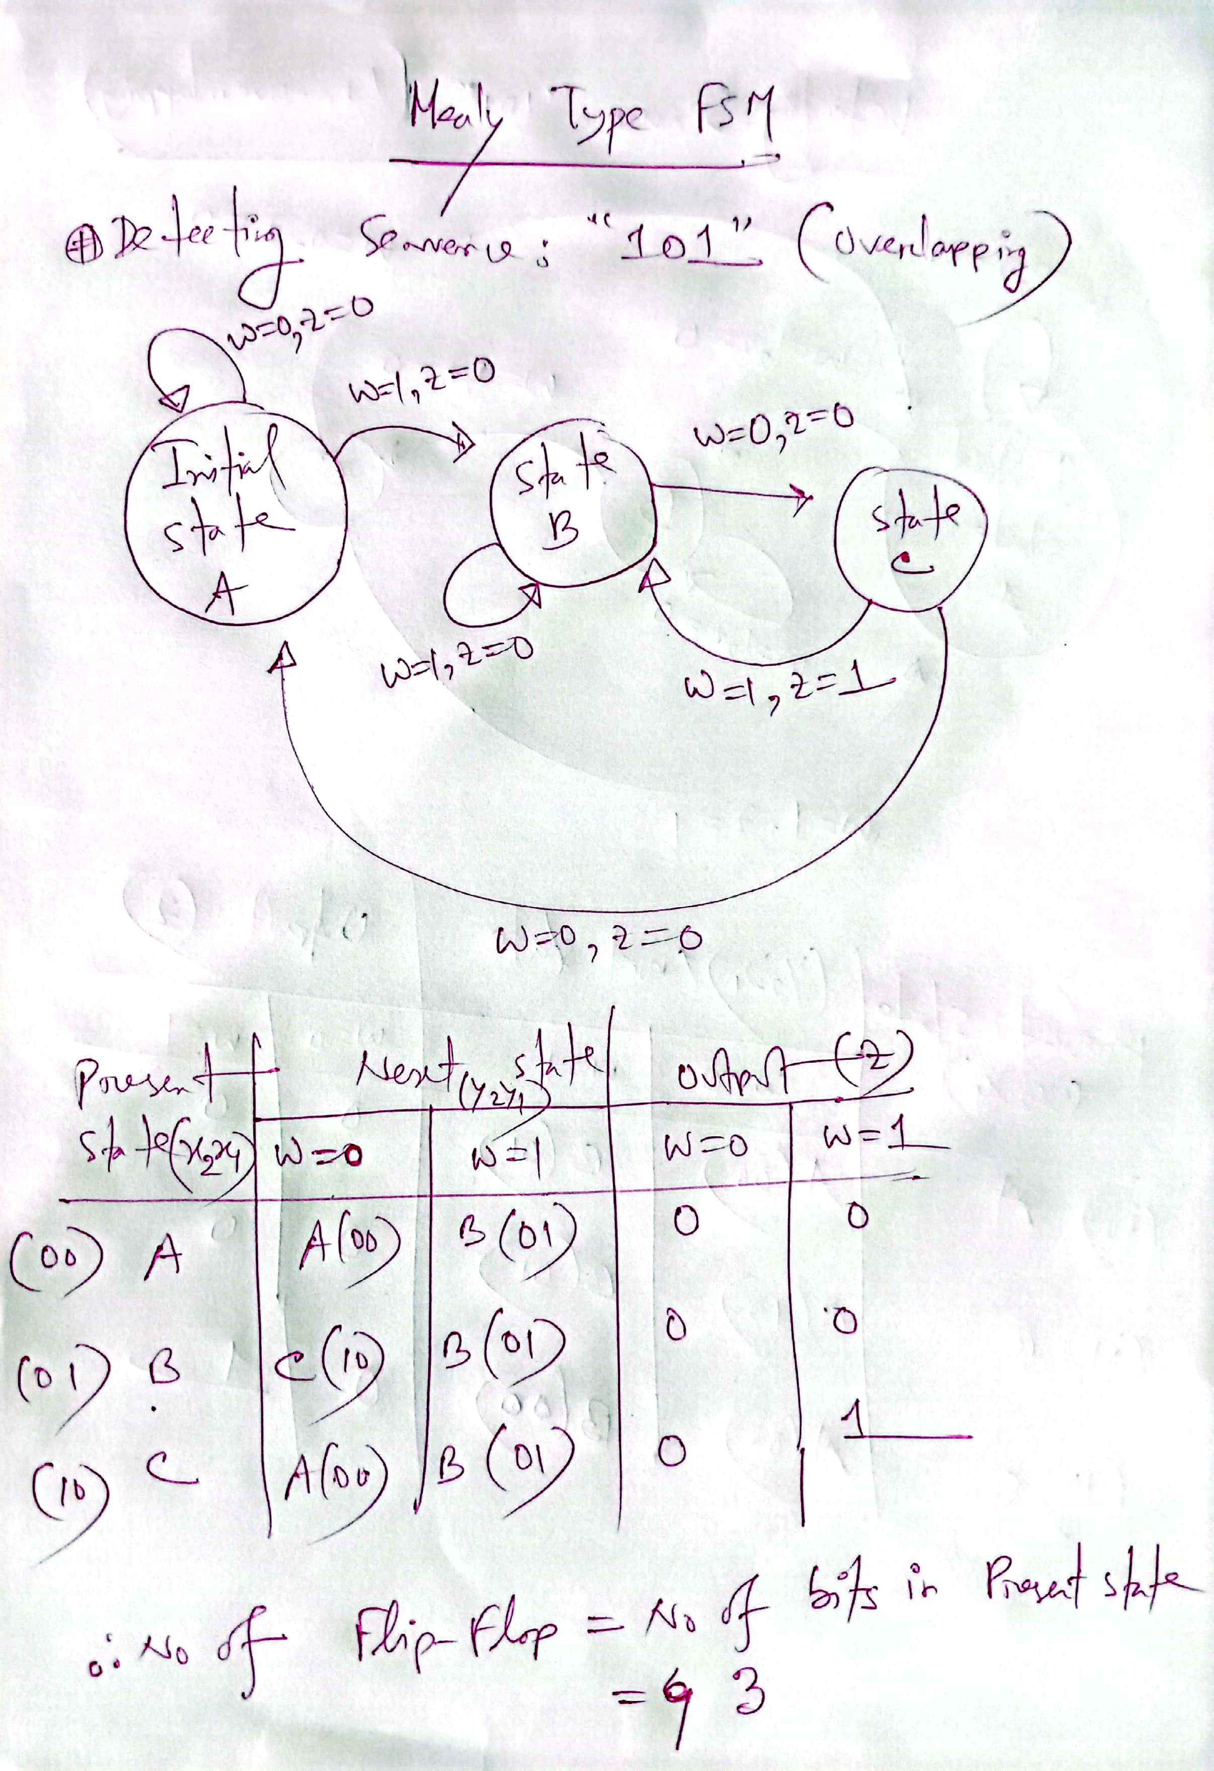
Example 3: A Simple Input Pattern (‘101’ Overlapping Sequence) Detection Circuit (Mealy Type)
Important:
In Mealy Type FSM, you do not need to declare a separate state for your final output (for this example: no separate state for ‘101’ is required). After getting your output z = 1, you will start your 2nd loop (Start finding z=1 for the 2nd time).
2

Slide 8
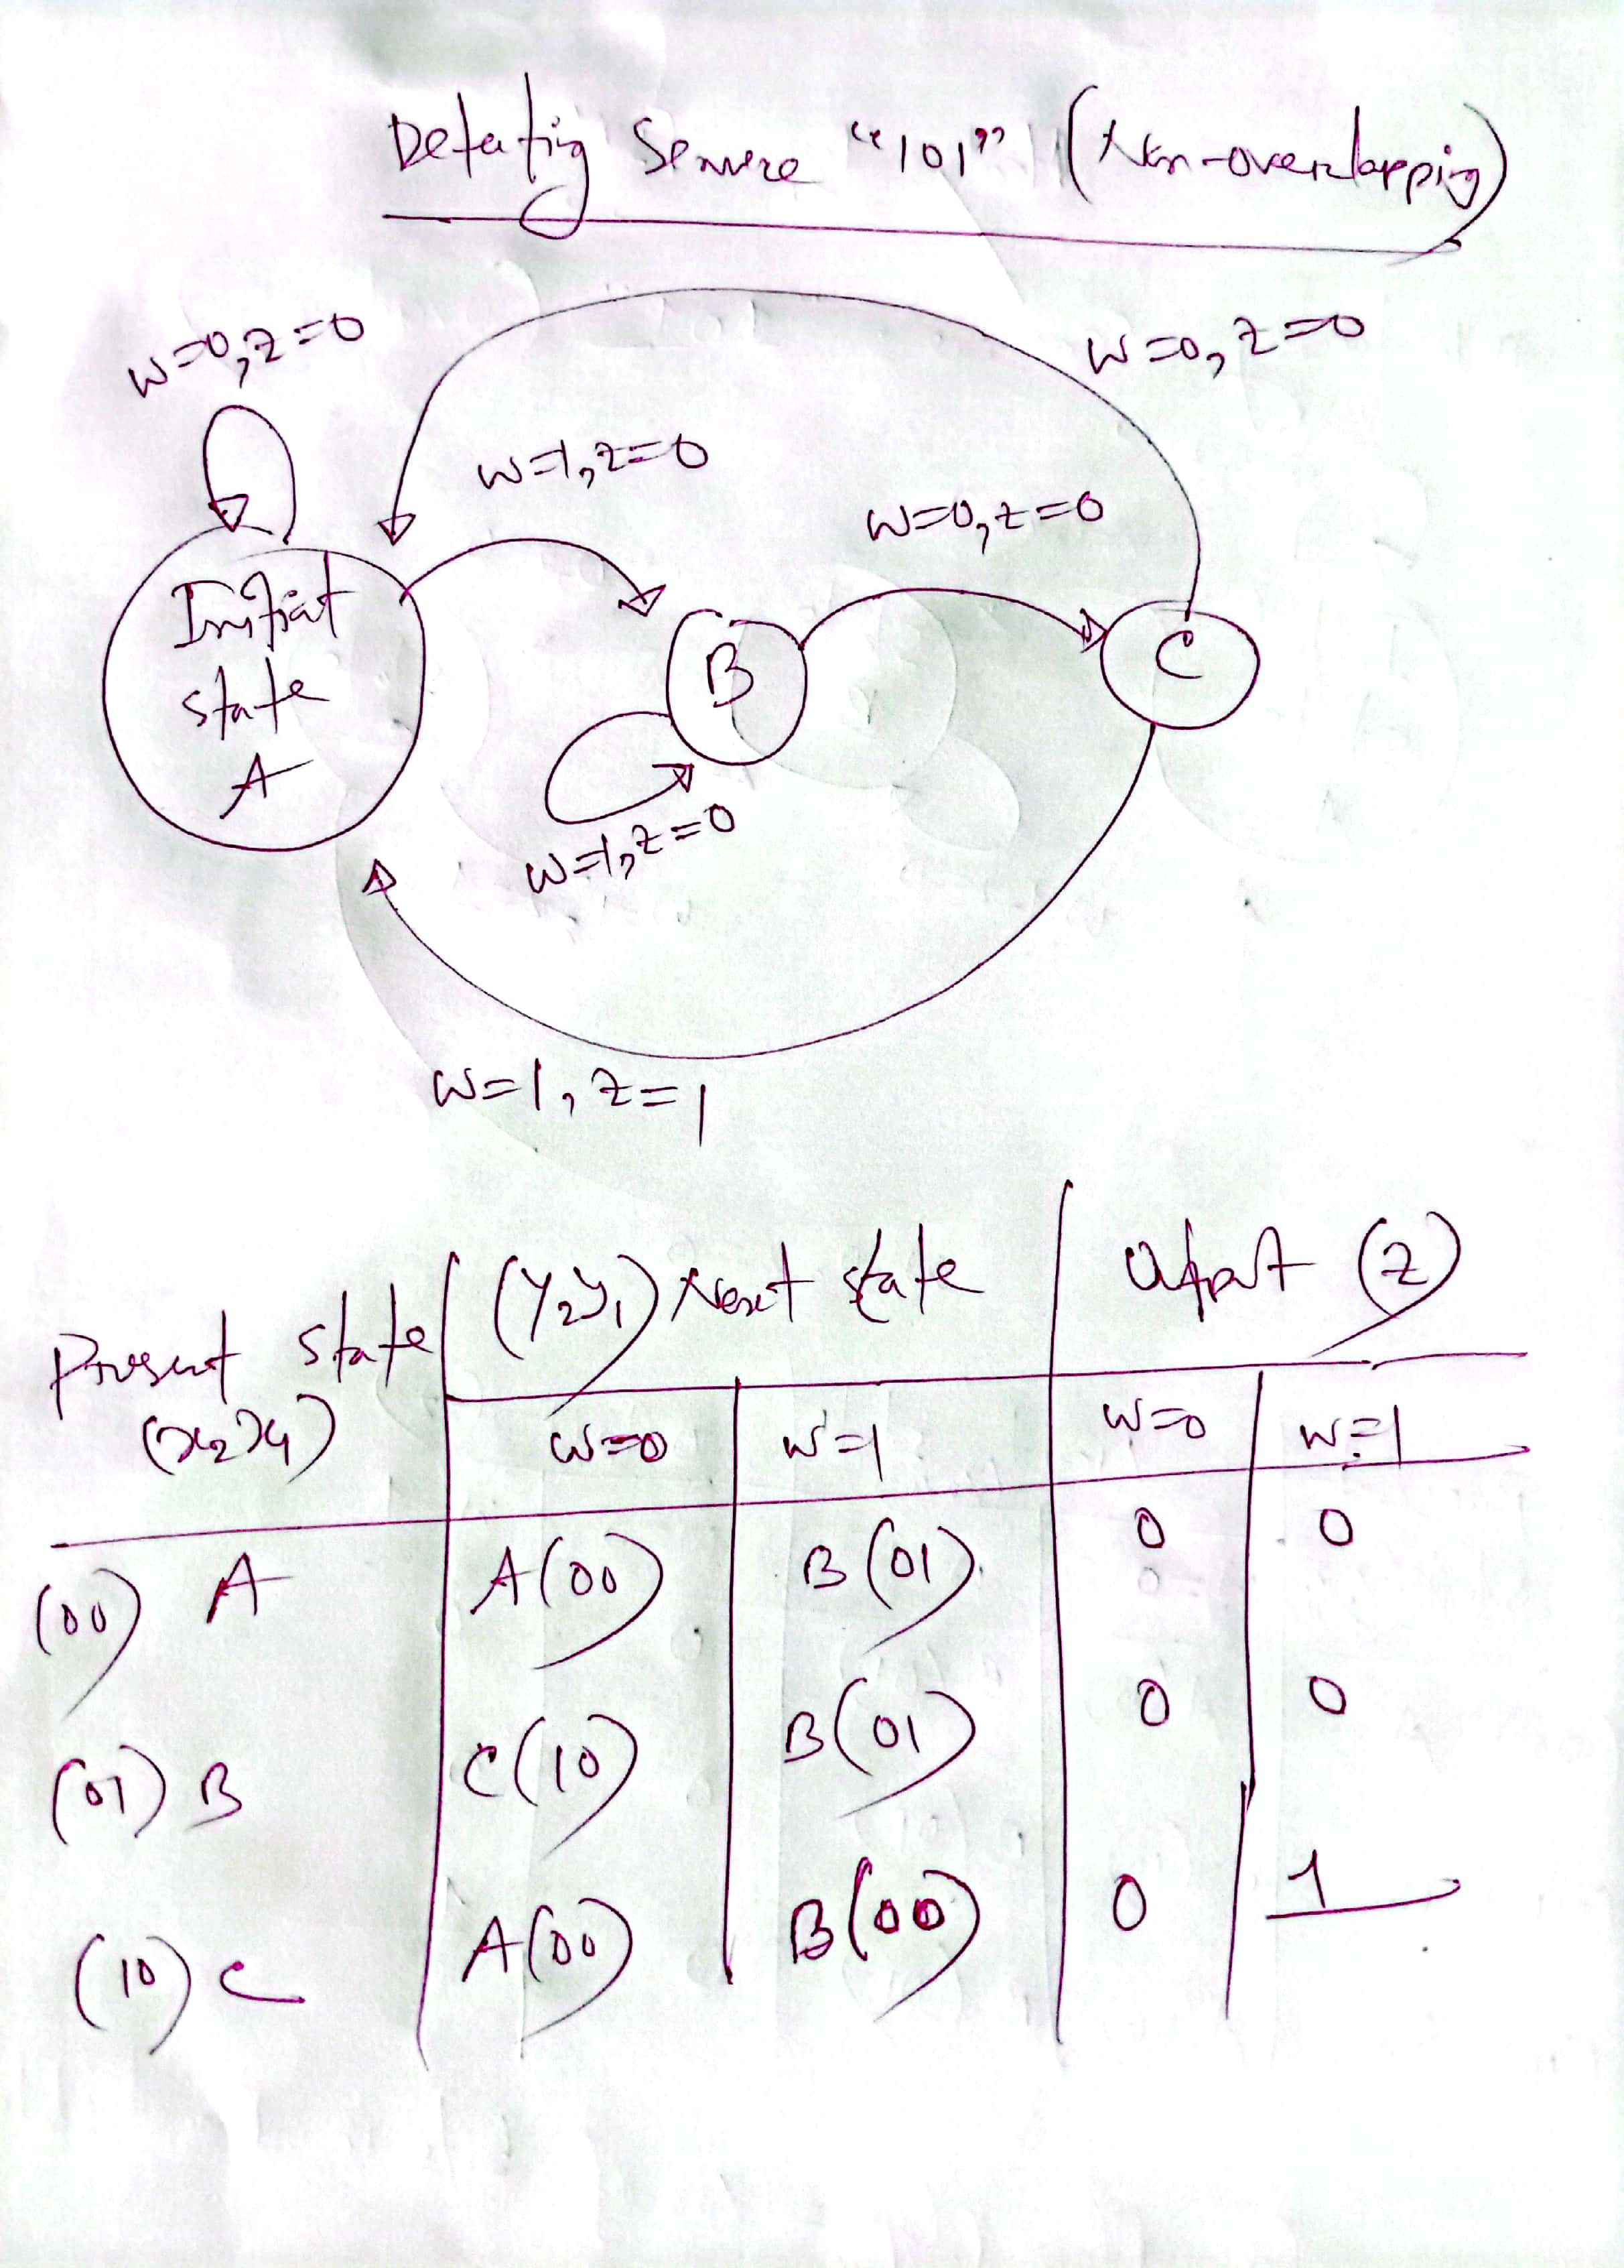
Example 4: A Simple Input Pattern (‘101’ Non-Overlapping Sequence) Detection Circuit (Mealy Type)
A (00)

Slide 9
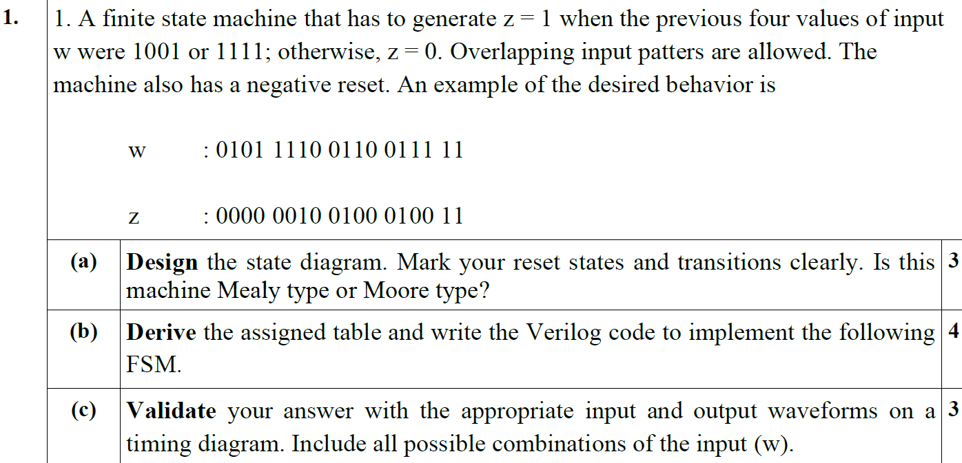
Example 5:

Slide 10
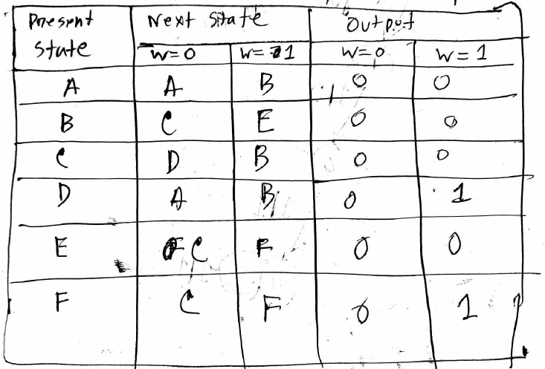
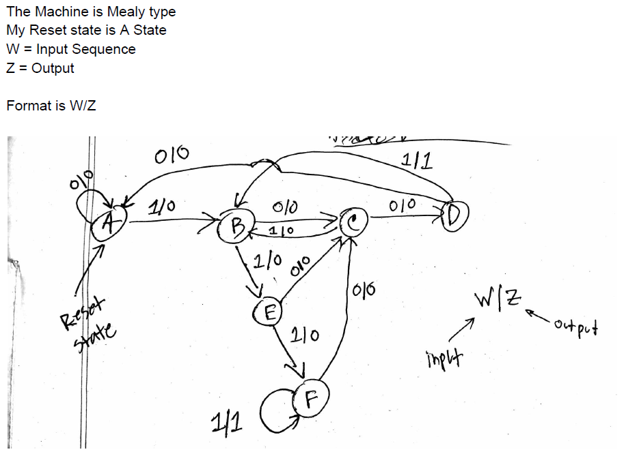
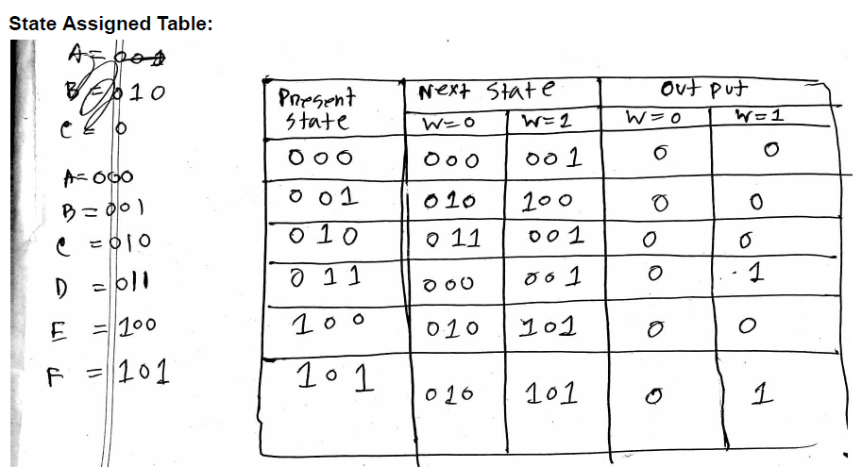
Solution:

Slide 11
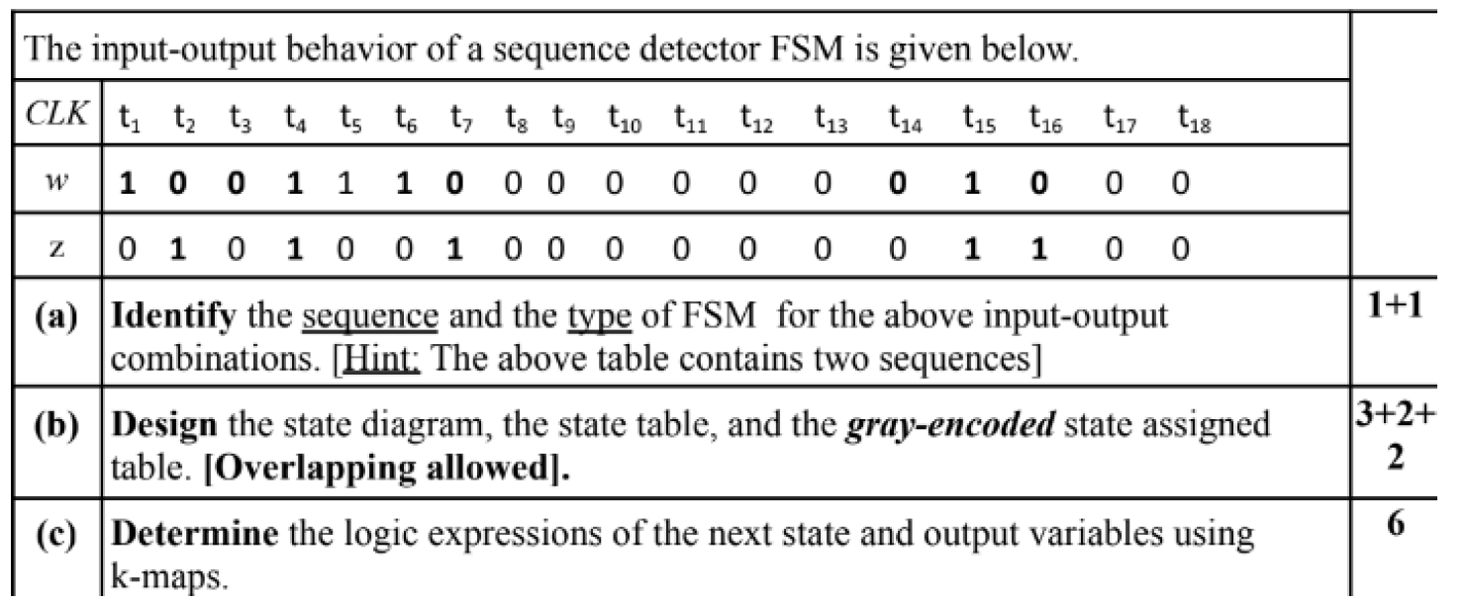
Example 6:
** Alternating 0 and 1
** Two consecutive inputs are different

Slide 12
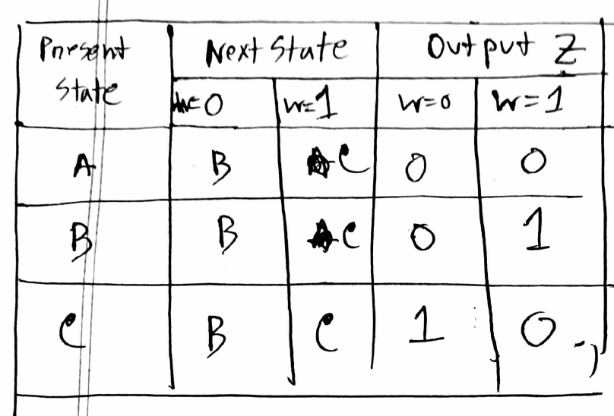
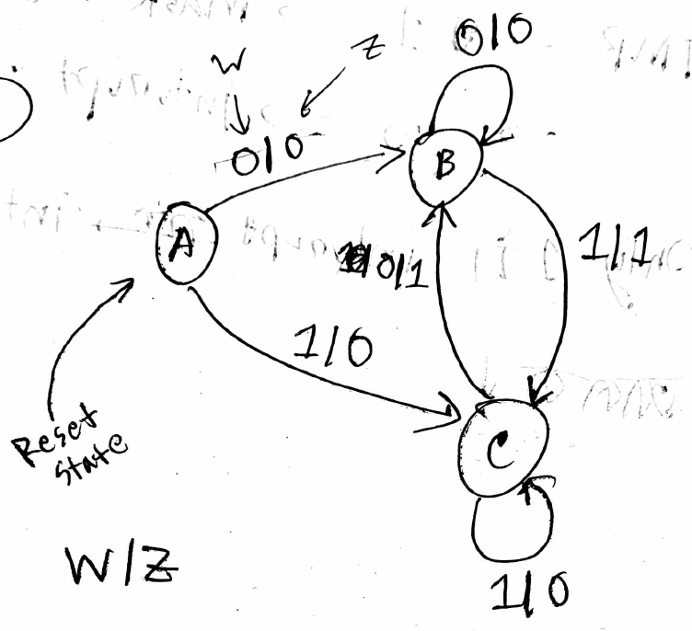
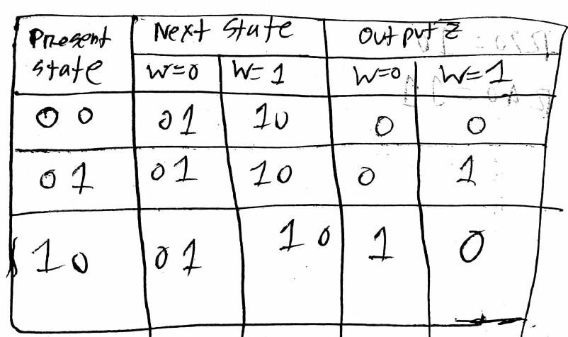
Solution:
11
11
11
11
Gray Encoding

Slide 13
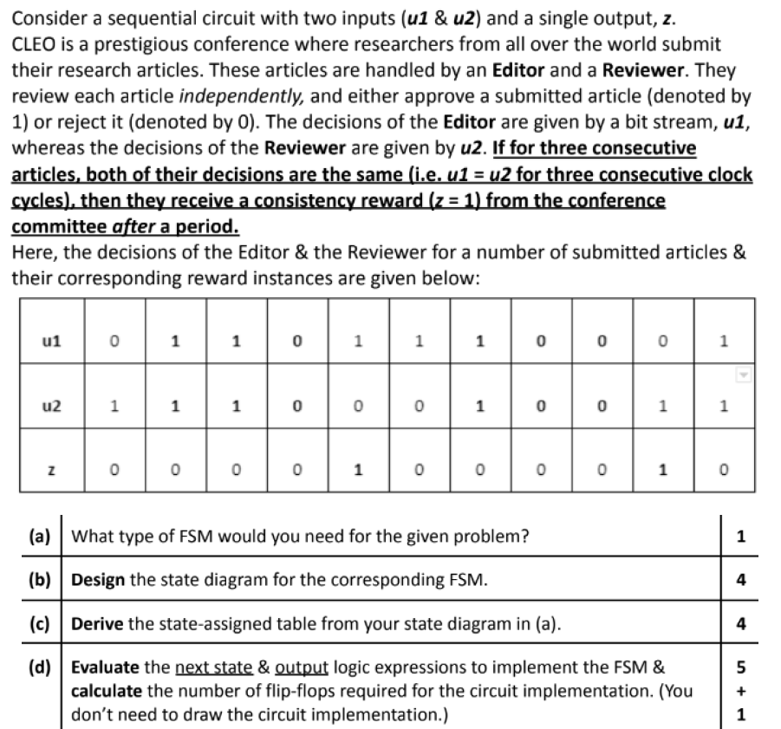
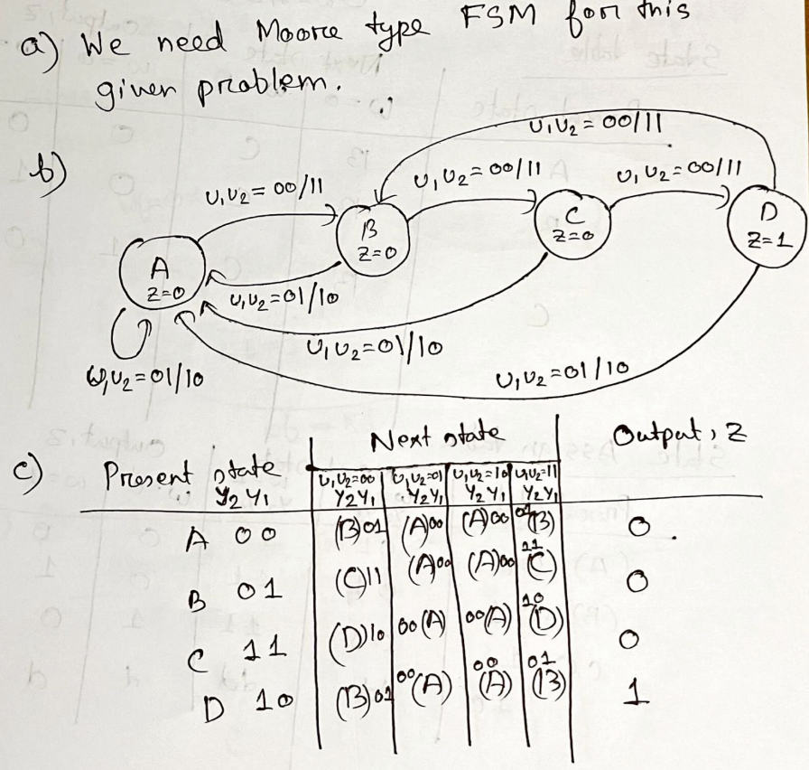
Example: 07: Double input FSM

Slide 14
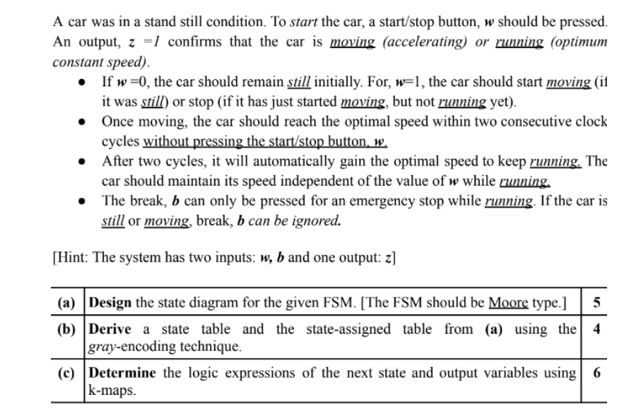
Example: 08: Double input FSM

Slide 15
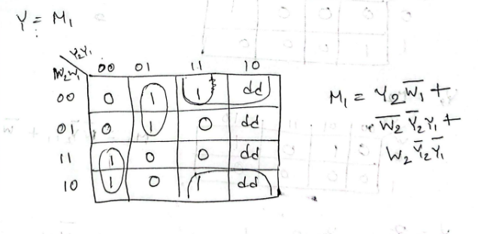
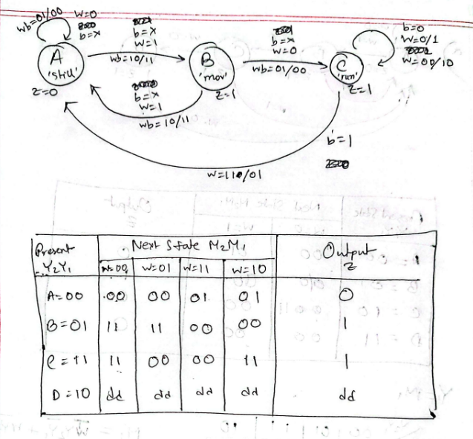
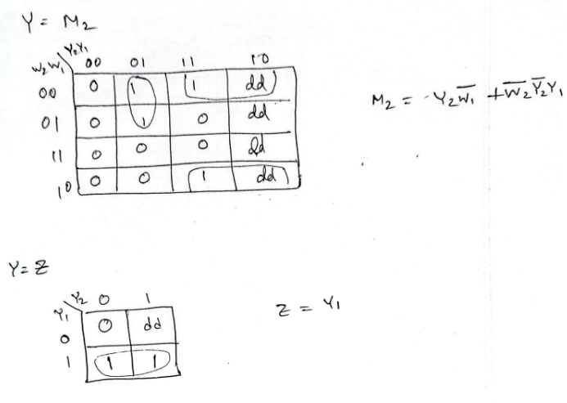
Example: 08: Double input FSM
b = X means, b is in a don’t care logic

Slide 16
Example: 09: Double output FSM
CLK | 1 | 2 | 3 | 4 | 5 | 6 | 7 | 8 | 9 | 10 | 11 | 12 | 13
w | 0 | 1 | 0 | 1 | 0 | 0 | 0 | 0 | 1 | 1 | 0 | 0 | 1
Z1 | 0 | 0 | 1 | 1 | 1 | 1 | 0 | 0 | 0 | 1 | 0 | 1 | 0
Z2 | 0 | 0 | 0 | 0 | 0 | 0 | 1 | 1 | 1 | 0 | 1 | 0 | 1
Solution: Moore Type FSM
For,
w = 01 or 10, Z1 = 1 and Z2 = 0
For,
w = 00 or 11, Z1 = 0 and Z2 = 1

Slide 17
Start
W=0
State C
‘00’
Z1=0
Z2=1
State
A
Z1=Z2=0
W=0
State B
‘0’
Z1=Z2=0
W=0
W=1
W=1
W=1
W=0
State F
‘01’
Z1=1
Z2=0
W=1
State D
‘1’
Z1=Z2=0
W=1
W=0
W=0
State G
‘11’
Z1=0
Z2=1
W=1
State E
‘10’
Z1=1
Z2=0
W=0
W=1

Slide 18
Present State (Y₂Y₁Y₀) | Next State (M₂M₁M₀) |  | Output
 | W = 0 | W = 1 | Z₂ | Z₁
A(000) | B | D | 0 | 0
B(001) | C | F | 0 | 0
C(010) | C | F | 1 | 0
D(011) | E | G | 0 | 0
E(100) | C | F | 0 | 1
F(101) | E | G | 0 | 1
G(110) | E | G | 1 | 0
H(111) | d | d | d | d

Slide 19
Example: 10: Double output FSM
CLK | 1 | 2 | 3 | 4 | 5 | 6 | 7 | 8 | 9 | 10 | 11 | 12 | 13
w | 0 | 1 | 0 | 1 | 0 | 0 | 0 | 0 | 1 | 1 | 0 | 0 | 1
Z1 | 0 | 0 | 1 | 0 | 1 | 0 | 0 | 0 | 0 | 1 | 0 | 0 | 0
Z2 | 0 | 0 | 0 | 0 | 0 | 0 | 1 | 1 | 1 | 0 | 0 | 0 | 1
Solution: Moore Type FSM
For,
w = 01, Z1 = 1 and Z2 = 0
For,
w = 00, Z1 = 0 and Z2 = 1

Slide 20
Start
State A
‘Initial’
Z1=0
Z2=1
W=0
State B
‘0’
Z1=Z2=0
W=1
W=0
W=1
W=0
W=1
State
D
‘01’
Z1=1
Z2=0
State C
‘00’
Z1=0
Z2=1
W=1
W=0

Slide 21
Example: 11: Double output FSM
CLK | 1 | 2 | 3 | 4 | 5 | 6 | 7 | 8 | 9 | 10 | 11 | 12 | 13
w | 0 | 1 | 0 | 1 | 0 | 0 | 0 | 0 | 1 | 1 | 0 | 0 | 1
Z1 | 0 | 0 | 1 | 0 | 1 | 0 | 0 | 0 | 0 | 1 | 0 | 0 | 0
Z2 | 0 | 0 | 0 | 1 | 0 | 1 | 0 | 0 | 0 | 0 | 0 | 1 | 0
Solution: Moore Type FSM
For,
w = 01, Z1 = 1 and Z2 = 0
For,
w = 10, Z1 = 0 and Z2 = 1

Slide 22
Start
W=0
State A
‘Initial’
Z1=0
Z2=0
W=0
State B
‘0’
Z1=Z2=0
W=1
W=1
W=0
State
D
‘1’
Z1=0
Z2=0
State
E
‘10’
Z1=0
Z2=1
State C
‘01’
Z1=1
Z2=0
W=0
W=1
W=0
W=1
W=1

Slide 23
Encoding Schemes (State Assignment)
Consider a state assigned table below:
Present state
Next state
w=0 w=1
Output
z
Schemes->
Binary encoding
Gray encoding
One-hot encoding
 | y ₂ y ₁ | Y ₂ Y ₁ | Y ₂ Y ₁
A | 00 | 00 | 01 | 0
B | 01 | 00 | 10 | 0
C | 10 | 00 | 10 | 1
 | 11 | dd | dd | d

Slide 24
Encoding Schemes (State Assignment)
Consider another state assigned table below:
Present state
Next state
w=0 w=1
Output
z
Schemes->
Binary encoding
Gray encoding
One-hot encoding
 | y ₂ y ₁ | Y ₂ Y ₁ | Y ₂ Y ₁
A | 00 | 00 | 01 | 0
B | 01 | 00 | 11 | 0
C | 11 | 00 | 11 | 1
 | 10 | dd | dd | d

Slide 25
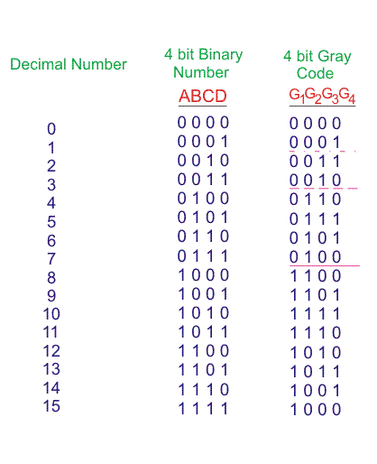

Slide 26
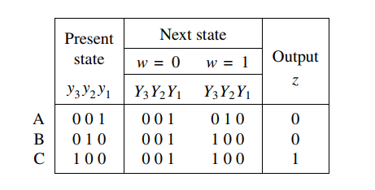
Encoding Schemes (State Assignment)
Consider another state assigned table below:
Schemes->
Binary encoding
Gray encoding
One-hot encoding
How many flipflops are required?
Ans: 3

